Slide 1
Activity Recognition
Dimitris Konstantakopoulos ΜΤΝ2013
Dimitra Manoura ΜΤΝ2015

Slide 2
Dataset
Our dataset consists of 51 different classes
Our classes are everyday human activities like like brushing hair, hugging, running etc.
We make sure that there are no corrupt videos
We check how many videos belong in each class and decide to delete the extra files from a few classes.
That leaves us with 102 videos for each class

Slide 3




Dataset
We augment our dataset by zoom in, flipping horizontally, rotating, and by keeping only a small percentage vertically and horizontally

Slide 4
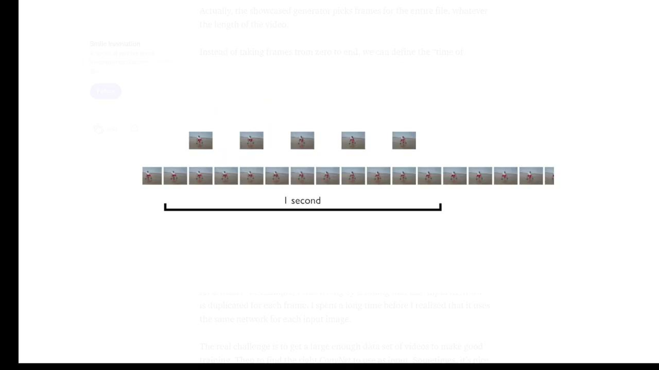
Video Frame Generator
We are going to extract frames from our videos in order to feed them to our network
To do that, we decided to use the SlidingGenerator that traverses through each video and extracts n-tuple frames from every consecutive second.

Slide 5
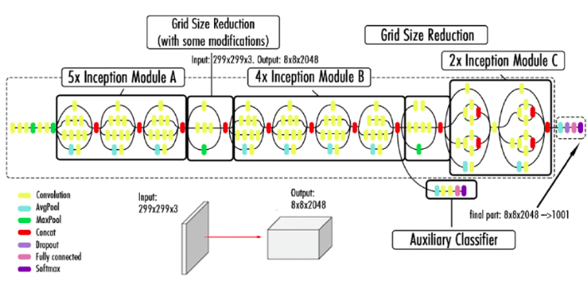
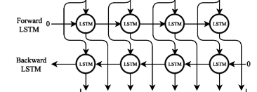
Model
InceptionV3 combined with Bidirectional LSTM

Slide 6

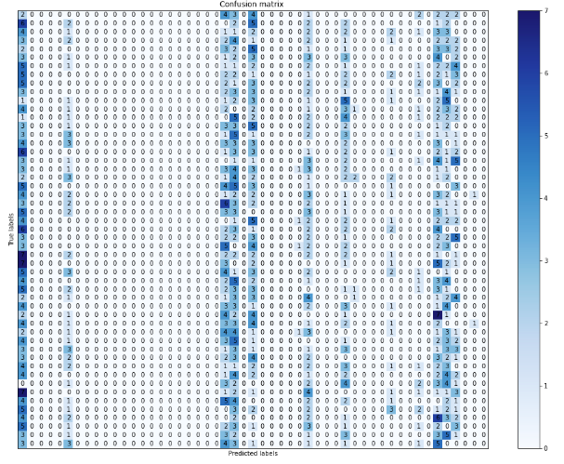
Results

Slide 7

It’s Demo time!

Slide 8
Conclusions
Overall, our model performed better than expected, given that with our dataset, the accuracy achieved in related work is around 75-80%.
Determinative factor: SlidingGenerator
We believe that our Data was too little for the amount of classes
Future work: code a “smart” generator of our own and evolve our model

Slide 9
Thank you!!!!

